Slide 1
ONE shot learning for recognition
Keren Ofek

Slide 2
Today’s Agenda
Similarity and how to measure it?
Embedding
One-Shot learning Challenges
Siamese Network
DeepNet
Triplets
FaceNet

Slide 3
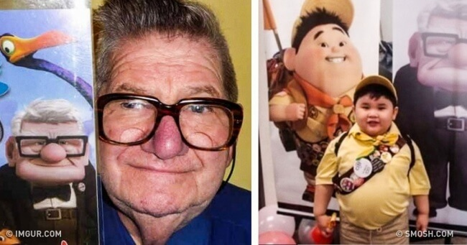
What is one shot learning?
One-shot learning aims to learn information about object categories from few training examples.
The idea is to understand the similarity between the detected object to an known object.
Image Source: Google

Slide 4
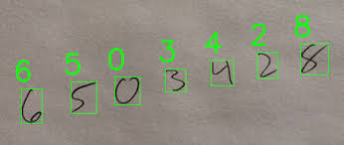
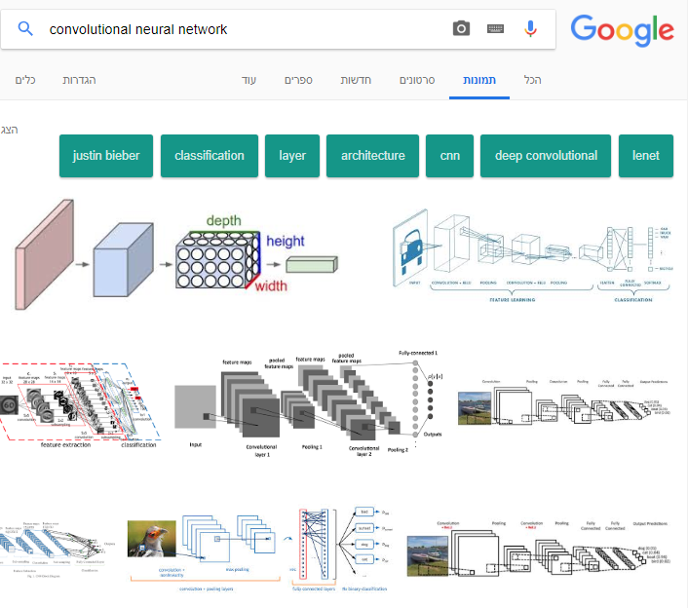

Similarity
1
3
2
Image Source: Google

Slide 5
How can we measure similarity?
We will find a function that quantifies a “distance” between every pair of elements in a set
Non-negativity: f(x, y) ≥ 0
Identity of Discernible: f(x, y) = 0 <=> x = y
Symmetry: f(x, y) = f(y, x)
Triangle Inequality: f(x, z) ≤ f(x, y) + f(y, z)

Slide 6
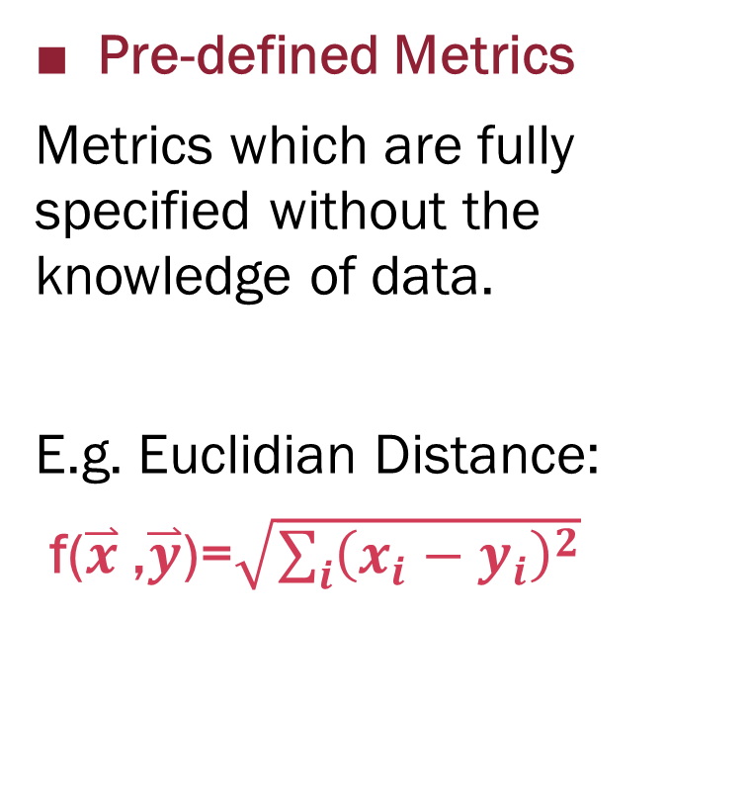
Which Distance Metric to choose?
Pre-defined Metrics
Metrics which are fully specified without the knowledge of data.
E.g. Euclidian Distance:
f($\overset{⃑}{x}$ ,$\overset{⃑}{y}$)=$\sqrt{\sum_{i}{{\left(x_{i}−y_{i}\right)}^{2}}}$
Learned Metrics
Metrics which can only be defined with the knowledge of the data:
Un-Supervised Learning
Or
Supervised Learning
Based on slide from: February-16 Lecture http://slazebni.cs.illinois.edu/spring17/

Slide 7
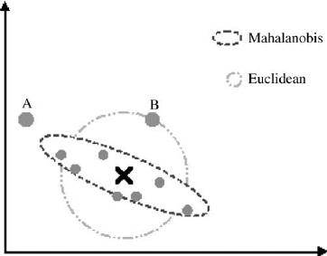
Un-supervised distance metric: : Mahalanobis Distance : f(x, y) = (x - y) ^{T}∑⁻¹(x - y) where ∑ is the mean-subtracted covariance matrix of all data points
From: Gene expression data clustering and visualization based on a binary hierarchical clustering framework

Slide 8
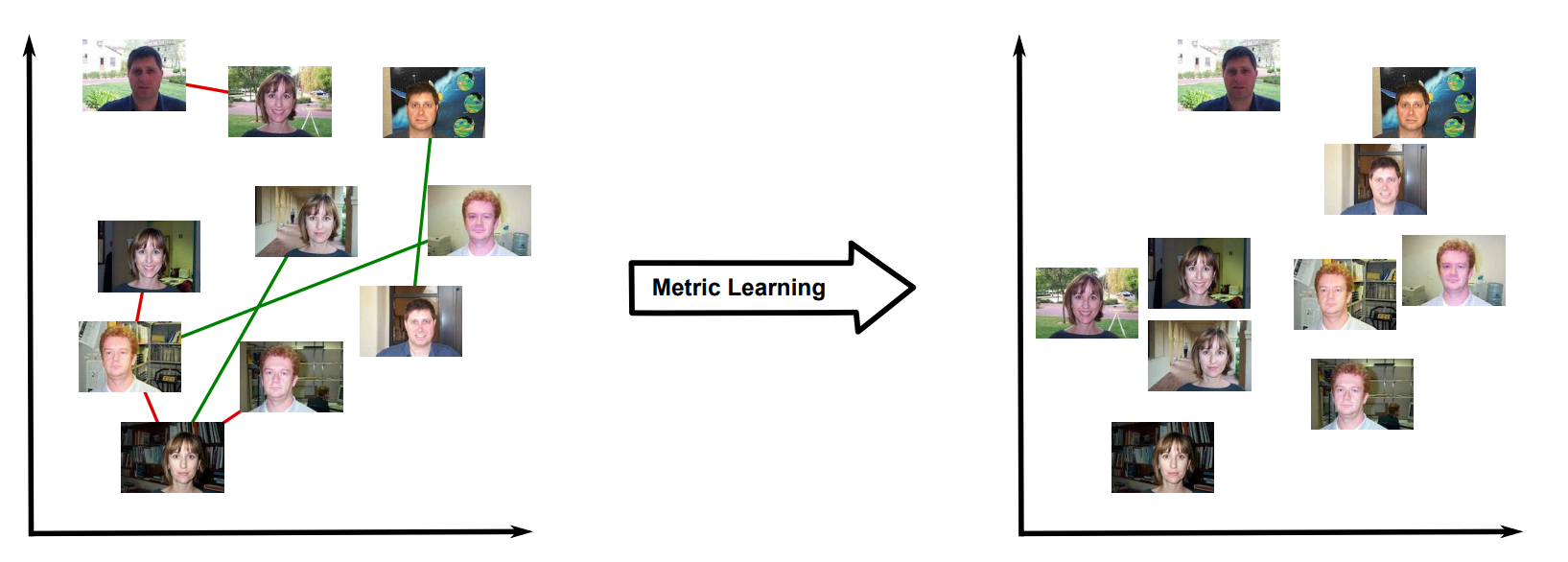
Un-supervised distance metric:
2-step procedure:
Apply some supervised domain transform:
Then use one of the un-supervised metrics for performing the mapping.
Bellet, A., Habrard, A. and Sebban, A survey on metric learning for feature vectors and structured data, 2013

Slide 9
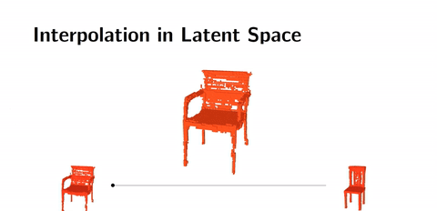
Embedding Process
The inputs are mapped to vectors in a low-dimensional space
low-dimensional space is called Target Space / Taken Space
In the taken Space, there is insensitivity intra category changes, but sensitivity to inter category changes
https://hackernoon.com/latent-space-visualization-deep-learning-bits-2-bd09a46920df
Notes:
https://hackernoon.com/latent-space-visualization-deep-learning-bits-2-bd09a46920df

Slide 10
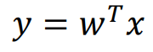
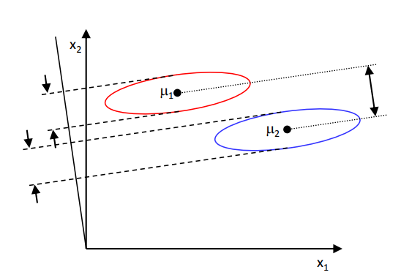
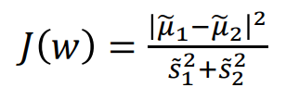
Linear Discriminant Analysis (LDA)
LDA based upon the concept of searching for a linear combination
of variables that best separates two classes:
Minimizes variance within the class
Maximizes variance between classes
Fisher
Ratio
LDA is an example to understand
the motivation of embedding
=
https://analyticsdefined.com/introduction-linear-discriminant-analysis/
Notes:
שיטות ישנות נוספות:
הפיכת תמונה להיסטוגרמה של צבעים
שימוש בL1
הבעיה בשימוש בשיטות הישנות היא שמראש אנחנו קובעים מהו הembedding ומהי פונקציית המרחק. לא תמיד יש התאמה בין המטרה שלנו (זיהוי תמונה) לבין הדרך הזו. למשל זיהוי אותו עצם על רקע שונה לגמרי / היפוך של התמונה יניב היסטוגרמה שונה לחלוטין.

Slide 11
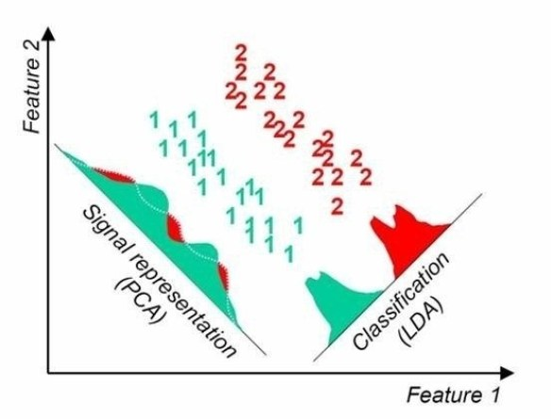
Linear Discriminant Analysis (LDA)
https://analyticsdefined.com/introduction-linear-discriminant-analysis/
Notes:
https://hackernoonhttps://www.youtube.com/watch?v=azXCzI57Yfc.com/latent-space-visualization-deep-learning-bits-2-bd09a46920df

Slide 12
The One-Shot learning challenge
There are lots of categories
The Number of categories is not always known
The number of samples in each category is small
One shot learning is super relevant in the field of computer vision: recognize objects in images from a single example.
Linear Models are not relevant in this field.
Notes:
נבצע את האמבדינג ובחירת המטריקה יחד, כחלק מ CNN
בניגוד לשיטות הישנות כמו היסטוגרמה של צבעים ומרחק אוקלידי.

Slide 13
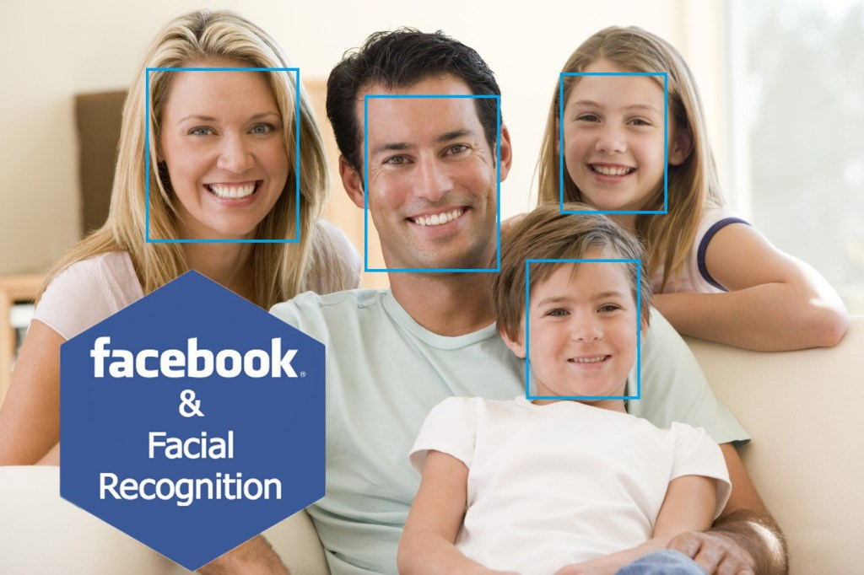
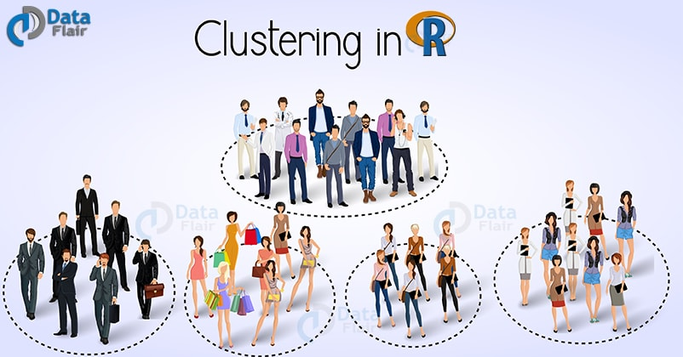
Face Recognition challenges
Verification
Recognition
Clustering

Slide 14
The Method - Using CNN:
The Idea is to learn a function that maps input patterns to target space.
non-linear mapping that can map any input vector to its corresponding low-dimensional version.
The distance in the target space approximates the “semantic” distance in the input space.
A discriminative training method - extract information about the problem from the available data, without requiring specific information about the categories.
The training will be on pairs of samples.
Notes:
The model does not learn the classification categories

Slide 15
Energy-based models (EBM)
EBM capture dependencies between variables by associating a scalar energy to each configuration of the variables.
No requirement for proper normalization
Provide considerably more flexibility in the design of architectures and training criteria than probabilistic approaches
LeCun, Chopra, Hadsell, Ranzato, Huang, A Tutorial on Energy-Based Learning, 2006

Slide 16
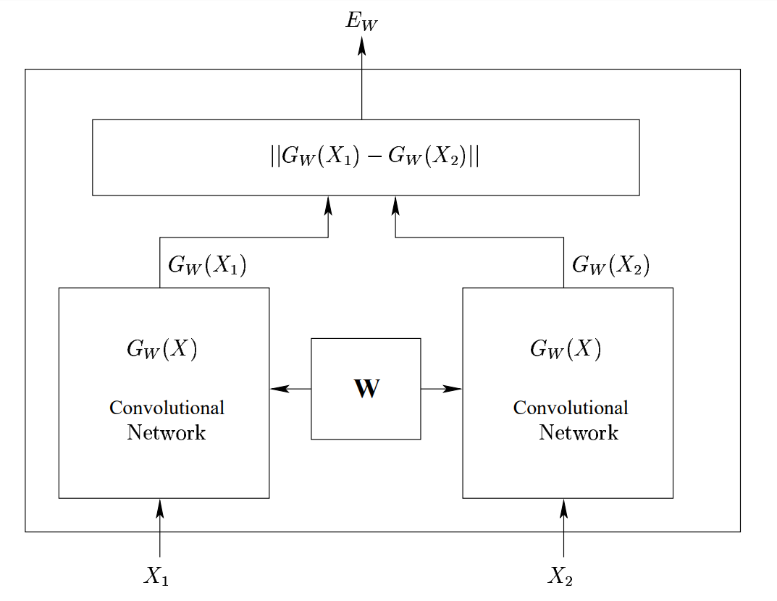
Siamese Network Architecture
Koch, Zemel, Salakhutdinov, Siamese Neural Networks for One-shot Image Recognition, 2015

Slide 17
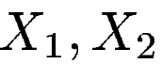
Similarity Metric
We seek to find a value of the parameter W such that:
- Same Category
Genuine Pair
Minimizes
- Different Categories
Impostor Pair
Maximizes
Contrastive term is needed to ensure: not only that the energy for a pair of inputs from the same category is low, but also that the energy for a pair from different categories is large.
Notes:
: The energy and the loss can be made zero by simply making Gw(x1) a constant function. Therefore our loss function needs a contrastive term to ensure not only that the energy for a pair of inputs from the same category is low, but also that the energy for a pair from different categories is large. This problem does not occur with properly normalized probabilistic models because making the probability of a particular pair high automatically makes the probability of other pairs low.

Slide 18
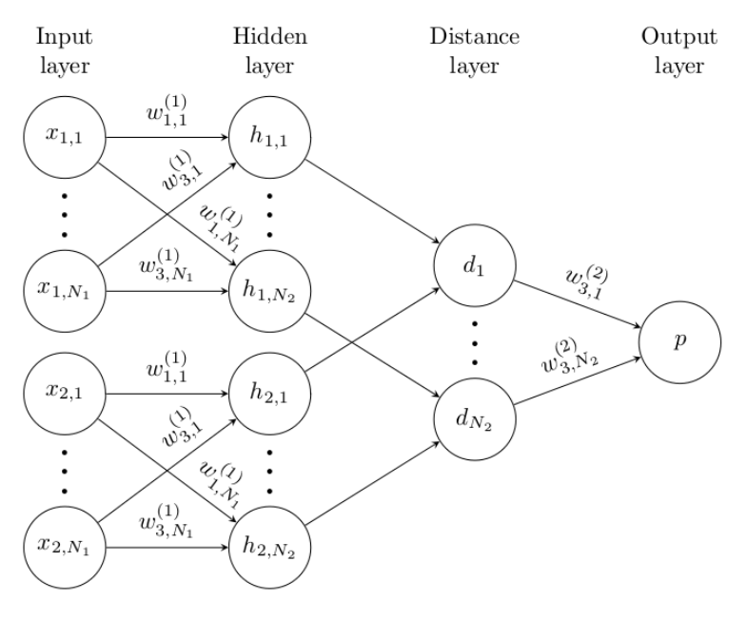
Siamese Neural Networks
Koch, Zemel, Salakhutdinov, Siamese Neural Networks for One-shot Image Recognition, 2015
Notes:
Siamese Neural Networks One-shot Image Recognition
P is a logistic function

Slide 19
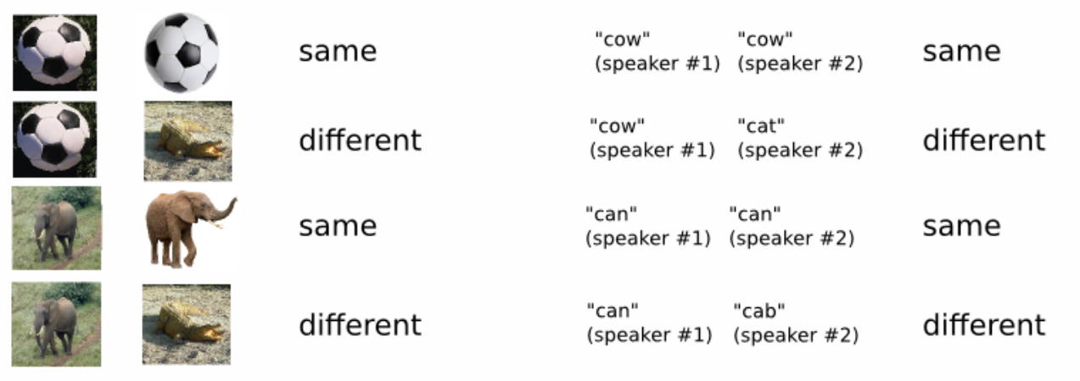
Siamese Neural Networks One-shot Image Recognition
Koch, Zemel, Salakhutdinov, Siamese Neural Networks for One-shot Image Recognition, 2015

Slide 20
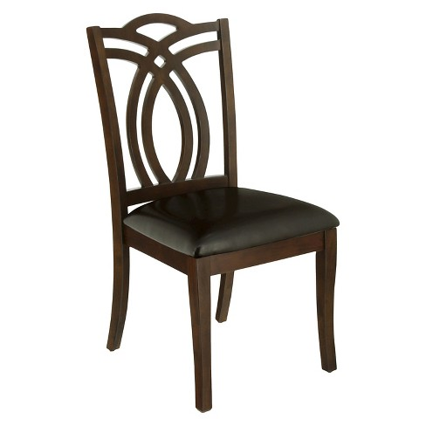
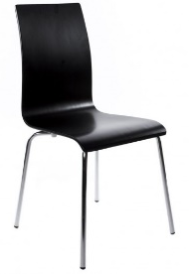
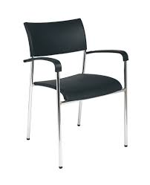
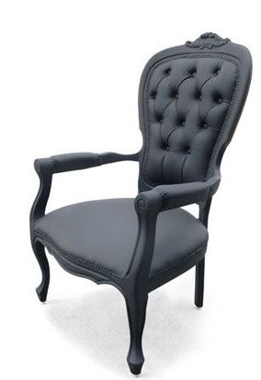
Hinge Loss: Positive pair
Embedding Space
L(x_{p}, x_{q}) = ||x_{p} – x_{q}||²
CNN
Query
Loss
Positive
CNN
https://www.cs.cornell.edu/~kb/publications/SIG15ProductNet.pdf
Notes:
Euclidian Loss
Bell, S. and Bala, K., 2015. Learning visual similarity for product design with convolutional neural networks. ACM Transactions on Graphics (TOG), 34(4), p.98.

Slide 21
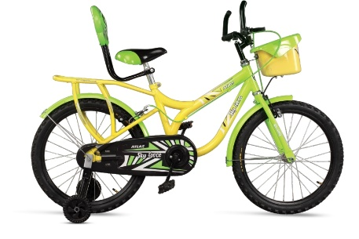
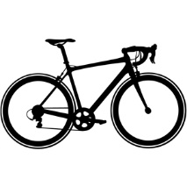
Hinge Loss Negative Pair
Embedding Space
L(x_{p}, x_{q}) = max(0, m² - || x_{p} – x_{q} || ² )
Margin (m)
CNN
Query
Loss = 0
Neg
CNN
https://www.cs.cornell.edu/~kb/publications/SIG15ProductNet.pdf
Notes:
Bell, S. and Bala, K., 2015. Learning visual similarity for product design with convolutional neural networks. ACM Transactions on Graphics (TOG), 34(4), p.98.

Slide 22
Hinge Loss Negative Pair
Embedding Space
L(x_{p}, x_{q}) = max(0, m² - || x_{p} – x_{q} || ² )
Margin (m)
Loss
CNN
Query
Neg
CNN
https://www.cs.cornell.edu/~kb/publications/SIG15ProductNet.pdf
Notes:
Bell, S. and Bala, K., 2015. Learning visual similarity for product design with convolutional neural networks. ACM Transactions on Graphics (TOG), 34(4), p.98.

Slide 23
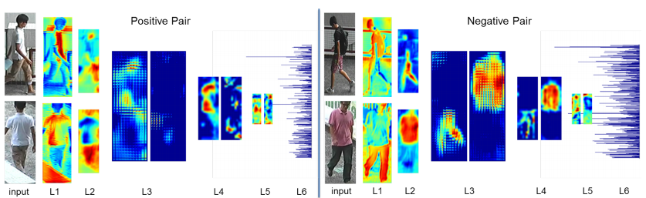
Visualization of Learned Features
Positive Pair
Negative Pair
Ahmed, Jones, Marks, An improved deep learning architecture for person re-identification, 2015

Slide 24
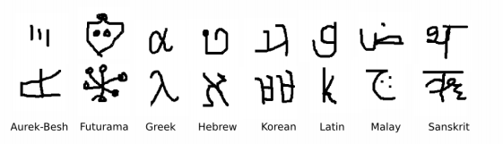
Example: Omniglot dataset
Omniglot contains examples from 50 alphabets:
well-established international languages (Latin and Korean)
lesser known local dialects.
Koch, Zemel, Salakhutdinov, Siamese Neural Networks for One-shot Image Recognition, 2015

Slide 25
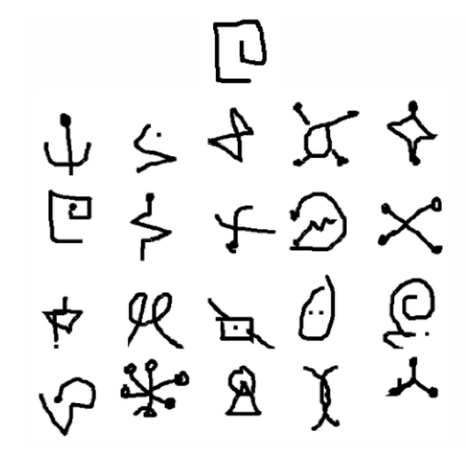
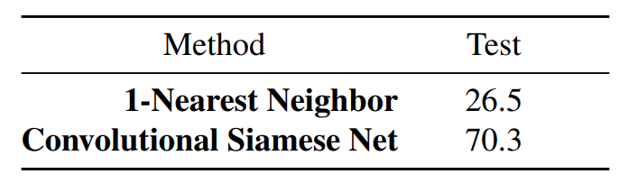
Omniglot dataset: classification task
Classes:
Input:
Results:
Koch, Zemel, Salakhutdinov, Siamese Neural Networks for One-shot Image Recognition, 2015
Notes:
20-way one-shot classification task

Slide 26
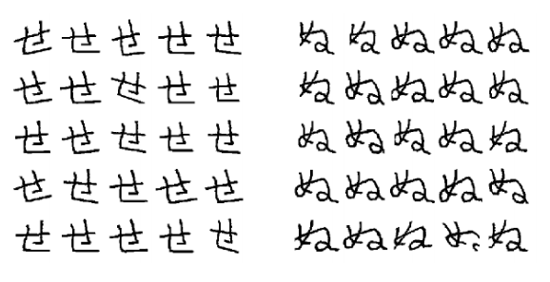
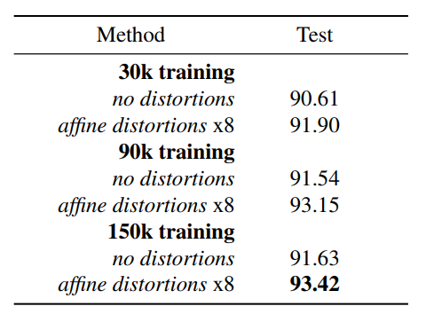
Omniglot dataset: Verification task
Training on 3 data set sizes with 30,000, 90,000, and 150,000
Sampling random same and different pairs.
Generating 8 random affine distortions for each category
Results:
Koch, Zemel, Salakhutdinov, Siamese Neural Networks for One-shot Image Recognition, 2015

Slide 27
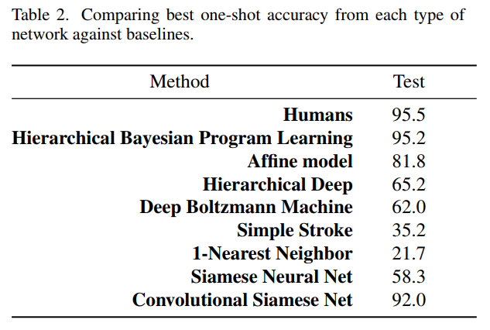
Koch, Zemel, Salakhutdinov, Siamese Neural Networks for One-shot Image Recognition, 2015

Slide 28
DeepFace (Facebook, 2014)
The conventional pipeline:
Detect ⇒ align ⇒ represent ⇒ classify
Face alignment: Transform a face to be in a canonical pose
Face representation: Find a representation of a face which is suitable for follow-up tasks (small size, computationally cheap to compare, invariant to irrelevant changes)
3D face modeling
A nine-layer deep neural network
More than 120 million parameters
Taigman; Yang; Ranzato, Wolf, DeepFace: Closing the Gap to Human-Level Performance in Face Verification, 2014

Slide 29
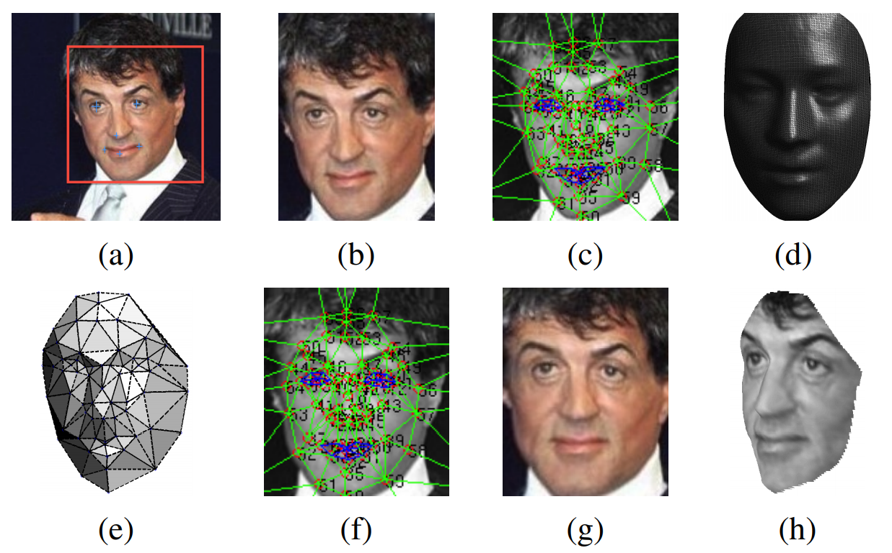
The alignment process - 'Frontalization'
Taigman; Yang; Ranzato, Wolf, DeepFace: Closing the Gap to Human-Level Performance in Face Verification, 2014
Notes:
*

Slide 30
The alignment process - 'Frontalization'
2D Alignment - detecting 6 fiducial points inside the detection crop, centered at the center of the eyes, tip of the nose and mouth locations
2D Alignment - aligned crop: composing the final 2D transformation
Taigman; Yang; Ranzato, Wolf, DeepFace: Closing the Gap to Human-Level Performance in Face Verification, 2014

Slide 31
The alignment process - 'Frontalization'
(c) 2D Alignment - localizing additional 67 fiducial points
(d) 3D Alignment - The reference 3D shape transformed to the 2D- aligned crop image-plane.
Taigman; Yang; Ranzato, Wolf, DeepFace: Closing the Gap to Human-Level Performance in Face Verification, 2014

Slide 32
The alignment process - 'Frontalization '
(e) 2D-3D Alignment - Triangle visibility w.r.t. to the fitted 3D-2D camera; darker triangles are less visible.
(f) 3D Alignment - The 67 fiducial points induced by the 3D model that are used to direct the piece-wise affine wrapping.
(g) 2D Alignment - The final frontalized crop
Taigman; Yang; Ranzato, Wolf, DeepFace: Closing the Gap to Human-Level Performance in Face Verification, 2014
Notes:
(h) 3D Alignment - A new view generated by the 3D model (not used in DeepFace).

Slide 33
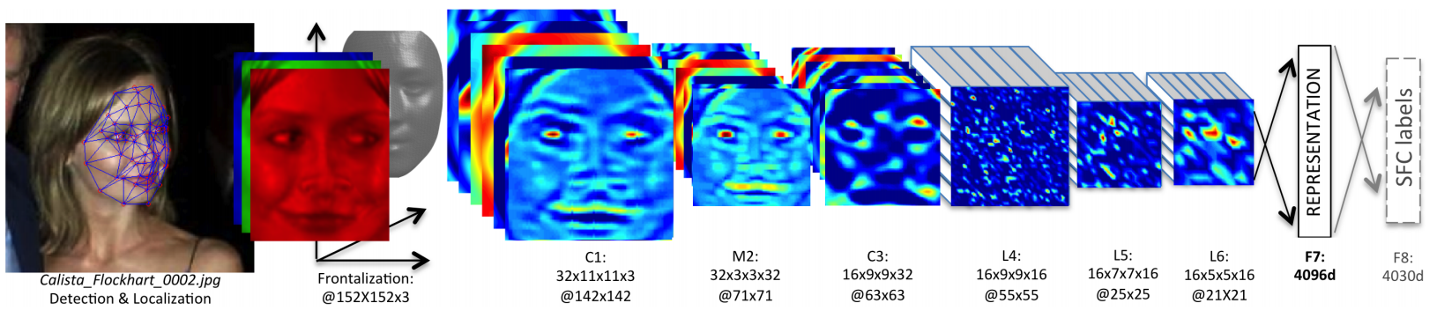
The DeepFace architecture
C1, M2, C3 : Extract low-level features (simple edges and texture)
L4, L5, L6: Locally connected Layers
L7, L8: Fully connected Layers
Taigman; Yang; Ranzato, Wolf, DeepFace: Closing the Gap to Human-Level Performance in Face Verification, 2014
Notes:
They use locally connected layers for the next three layers. This is like a convolutional layer but with each part of the image learning a different filter bank, which makes sense because the face has been normalized and the filters relevant for one part of the face probably is not for another.
Areas between the eyes and the eyebrows exhibit very different appearance and have much higher discrimination ability compared to areas between the nose and the mouth.
The use
of local layers does not affect the computational burden of
feature extraction, but does affect the number of parameters
subject to training. Only because we have a large labeled
dataset, we can afford three large locally connected layers.

Slide 34
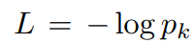
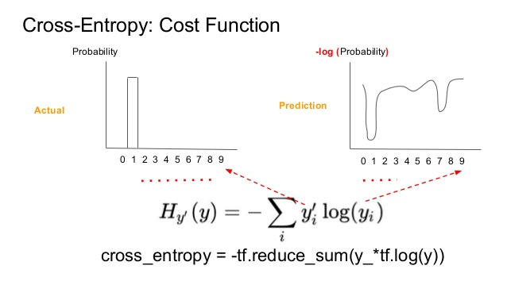
The training process
We use cross-entropy as the loss function:
(K is the index of the true label for a given input)
The loss is minimized over the parameters by computing the gradient of L with respect to the parameters and by updating the parameters using stochastic gradient descent (SGD).
The gradients are computed by standard backpropagation of the error.

Slide 35
Notes:
Backup after slide “The training process” – Deepface

Slide 36
Face verification
In order to tell whether two images of faces show the same person they try three different methods.
Each of these relies on the vector extracted by the first fully connected layer in the network (4096d).
Let these vectors be f1 (image 1) and f2 (image 2). The methods are then:
Inner product
Weighted X^2 (chi-squared) distance
Siamese network.
Notes:
Let these vectors be f1 (image 1) and f2 (image 2). The methods are then:
Inner product between f1 and f2. The classification (same person/not same person) is then done by a simple threshold.
Weighted X^2 (chi-squared) distance. Equation, per vector component i: weight_i (f1[i] - f2[i])^2 / (f1[i] + f2[i]). The vector is then fed into an SVM.
Siamese network. Means here simply that the absolute distance between f1 and f2 is calculated (|f1-f2|), each component is weighted by a learned weight and then the sum of the components is calculated. If the result is above a threshold, the faces are considered to show the same person.

Slide 37
Results
LFW (Labeled Faces in the Wild): 13,323 web photos of 5,749 celebrities
Human Performance : 97.5% accuracy
The DeepFace Performance: 97.35% accuracy
YTF (YouTube Faces): 3425 YouTube videos of 1,595 subjects
The DeepFace Performance: 92.5% accuracy
(reduces the previous error by more than 50%!)
Notes:
YTF : We employ the DeepFace-single representation directly by creating, for every pair of training videos, 50 pairs of frames, one from each video, and label these as same or not-same in accordance with the video training pair. Then a weighted χ 2 model is learned as in Sec. 4.1. Given a test-pair, we sample 100 random pairs of frames, one from each video, and use the mean value of the learned weighed similarity. The comparison with recent methods is shown in Table 4 and Fig. 4. We report an accuracy of 91.4% which reduces the error of the previous best methods by more than 50%. Note that there are about 100 wrong labels for video pairs, recently updated to the YTF webpage. After these are corrected, DeepFace-single actually reaches 92.5%. This experiment verifies again that the DeepFace method easily generalizes to a new target domain.

Slide 38
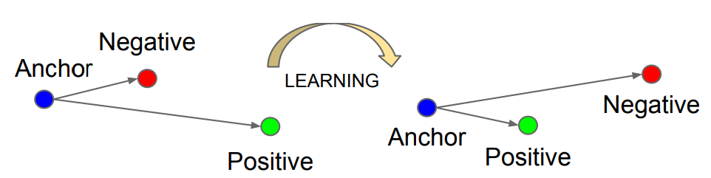
Triplets Network
The Triplet Loss minimizes the distance between an anchor and a positive, both of which have the same identity, and maximizes the distance between the anchor and a negative of a different identity.
Notes:
where N is a possible set of all triplets in the dataset; f (x) - embedding, that translates image x into Euclidean space; x a j - ”anchor” image; x p j - ”positive” image, which should be close to an anchor image; x n j - ”negative” image; γ - margin between positive and negative images.

Slide 39
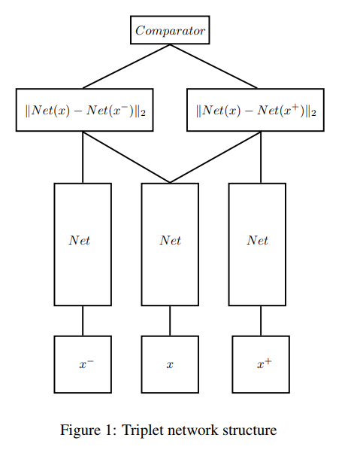
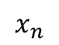
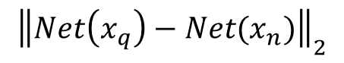
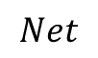

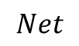
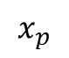
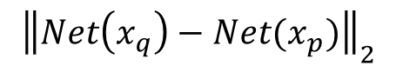
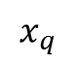
Triplet Network
Comparator
$${\left\|Net\left(x_{q}\right)−Net(x_{n})\right\|}_{2}$$
$${\left\|Net\left(x_{q}\right)−Net(x_{p})\right\|}_{2}$$
$$Net$$
$$Net$$
$$Net$$
$$x_{n}$$
$$x_{q}$$
$$x_{p}$$
Hoffer, Ailon, DEEP METRIC LEARNING USING TRIPLET NETWORK , 2015

Slide 40
FaceNet (Google, 2015)
FaceNet approach is that they use Euclidean embedding space to find the similarity or difference between faces.
The method uses a deep convolutional network trained to directly optimize the embedding itself, rather than an intermediate bottleneck layer as in previous deep learning approaches.
They used large-scale dataset
https://arxiv.org/pdf/1503.03832v3.pdf

Slide 41
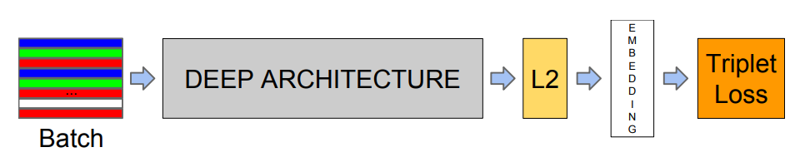
The training process
The network consists of a batch input layer and a deep CNN followed by L2 normalization, which results in the face embedding. This is followed by the triplet loss during training.
Schroff, Kalenichenko, Philbin, FaceNet: A Unified Embedding for Face Recognition and Clustering, 2015

Slide 42
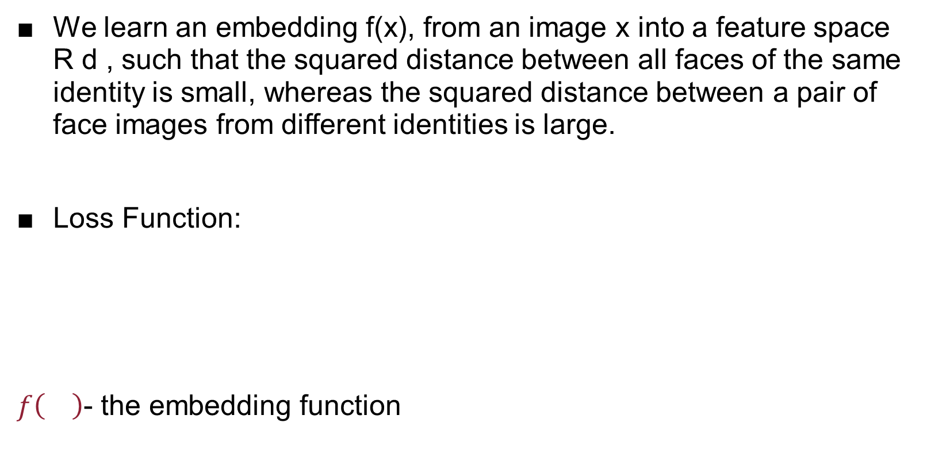
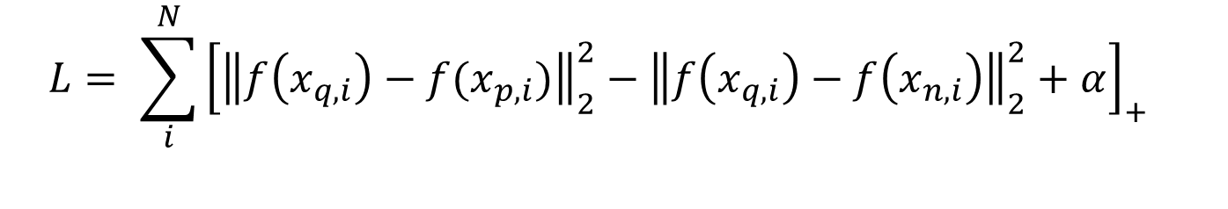
The training process
We learn an embedding f(x), from an image x into a feature space R d , such that the squared distance between all faces of the same identity is small, whereas the squared distance between a pair of face images from different identities is large.
Loss Function:
$f\left(\right)$- the embedding function
$${L= \sum_{i}^{N}{{\left[{\left\|f\left(x_{q,i}\right)−f(x_{p,i})\right\|}_{2}^{2}−{\left\|f\left(x_{q,i}\right)−f\left(x_{n,i}\right)\right\|}_{2}^{2}+α\right]}_{+}}}_{}$$
Notes:
α is a margin that is enforced between positive and negative pairs. Superscript a, p, n denote the anchor, positive and negative, respectively

Slide 43
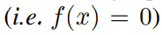
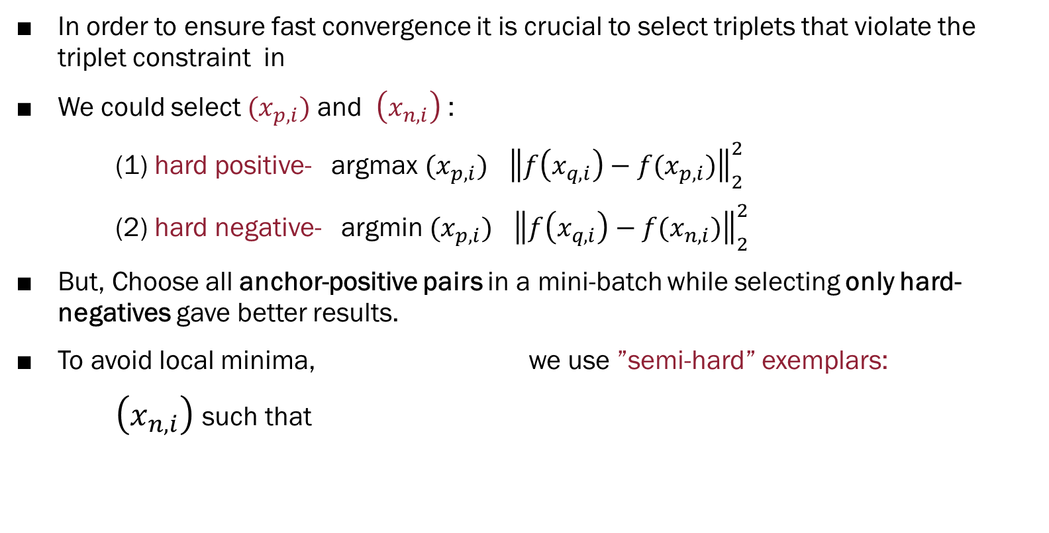
Triplets Selection
In order to ensure fast convergence it is crucial to select triplets that violate the triplet constraint in
We could select $(x_{p,i})$ and $\left(x_{n,i}\right)$ :
(1) hard positive- argmax $(x_{p,i})$ ${\left\|f\left(x_{q,i}\right)−f(x_{p,i})\right\|}_{2}^{2}$
(2) hard negative- argmin $(x_{p,i})$ ${\left\|f\left(x_{q,i}\right)−f(x_{n,i})\right\|}_{2}^{2}$
But, Choose all anchor-positive pairs in a mini-batch while selecting only hard-negatives gave better results.
To avoid local minima, we use ”semi-hard” exemplars:
$\left(x_{n,i}\right)$ such that
$${\left\|f\left(x_{q,i}\right)−f(x_{p,i})\right\|}_{2}^{2}+α<{\left\|f\left(x_{q,i}\right)−f\right\|}_{2}^{2}$$
$${\left\|f\left(x_{q,i}\right)−f(x_{p,i})\right\|}_{2}^{2}<{\left\|f\left(x_{q,i}\right)−f\right\|}_{2}^{2}$$
Notes:
α is a margin that is enforced between positive and negative pairs. Superscript a, p, n denote the anchor, positive and negative, respectively

Slide 44
Triplets
Hard Negative
Hard Positive
Embedding location of anchor
Negative Space
Positive Space

Slide 45

The Model structure (after the training)
DISTANCE
Input

Slide 46
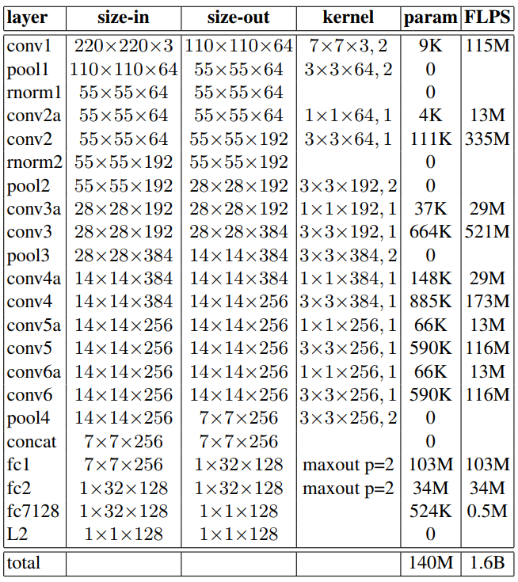
The FaceNet architecture (NN1)
Schroff, Kalenichenko, Philbin, FaceNet: A Unified Embedding for Face Recognition and Clustering, 2015

Slide 47
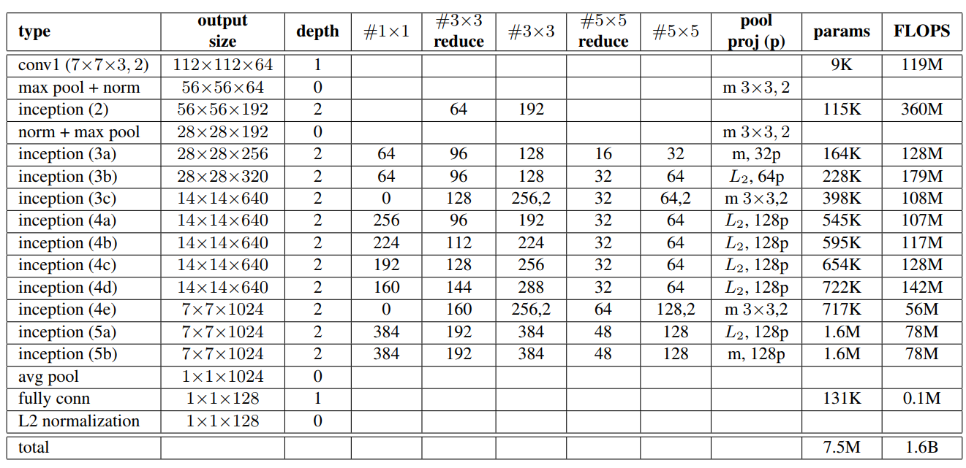
The FaceNet architecture (NN2)
Schroff, Kalenichenko, Philbin, FaceNet: A Unified Embedding for Face Recognition and Clustering, 2015

Slide 48
The results – New records!
Performance on Youtube Faces DB: 95.12% accuracy
Performance on Labeled Faces in the Wild DB: 99.63% accuracy
Sensitivity to Image Quality:
(The CNN was trained on 220x220 input images)
# Pixels | Val-Rate
1,600 | 37.8%
6,400 | 79.5%
14,400 | 84.5%
25,600 | 85.7%
65,539 | 86.4%
Schroff, Kalenichenko, Philbin, FaceNet: A Unified Embedding for Face Recognition and Clustering, 2015

Slide 49


FaceNet – Image clustering
Schroff, Kalenichenko, Philbin, FaceNet: A Unified Embedding for Face Recognition and Clustering, 2015

Slide 50
Summary
The subjects we covered:
Embedding - Similarity in taken space
One-Shot learning Challenges
Network principles: Siamese Network and Triplets
Network in used: DeepNet and FaceNet

Slide 51
References
Chopra, Hadsell, LeCun, Learning a Similarity Metric Discriminatively, with Application to Face Verification , 2005
Taigman; Yang; Ranzato, Wolf, DeepFace: Closing the Gap to Human-Level Performance in Face Verification, 2014
Schroff, Kalenichenko, Philbin, FaceNet: A Unified Embedding for Face Recognition and Clustering, 2015
Koch, Zemel, Salakhutdinov, Siamese Neural Networks for One-shot Image Recognition, 2015
Hermans, Beyer, Leibe, In Defense of the Triplet Loss for Person Re-Identification, 2017
LeCun, Chopra, Hadsell, Ranzato, Huang, A Tutorial on Energy-Based Learning, 2006
Bell, Bala, Learning visual similarity for product design with convolutional neural networks, 2015
Ahmed, Jones, Marks, An improved de ep learning architecture for person re-identification, 2015
Nando de Freias, Max-margin learning, transfer and memory networks, 2015
Jagannatha Rao, Wang, Cottrell, A Deep Siamese Neural Network Learns the Human-Perceived Similarity Structure of Facial Expressions Without Explicit Categories, 2011
Hoffer, Ailon, DEEP METRIC LEARNING USING TRIPLET NETWORK , 2015
Bellet, Habrard, Sebban, A survey on metric learning for feature vectors and structured data, 2013

Slide 52
Thanks!
Keren Ofek

